Slide 1
Classification Groups
Year 7 Science

Slide 2

Review
Which kingdom do kangaroos belong to?
What is the scientific name for lions?
What do the phylum chordata have in common?
What is a dichotomous key?

Slide 3
Learning Intentions
Grouping a variety of organisms on the basis of similarities and differences in particular features

Slide 4
Success criteria
Describe features of arthropods, and their subgroups (insects, arachnids, crustaceans and myrapods).
Give examples of insects, arachnids, crustaceans and myrapods.

Slide 5

Arthropods 12/03/2024
Arthropods have an exoskeleton and jointed legs.
They can live on land or in water
Arthropods include insects, arachnids, crustaceans and myrapods.

Slide 6
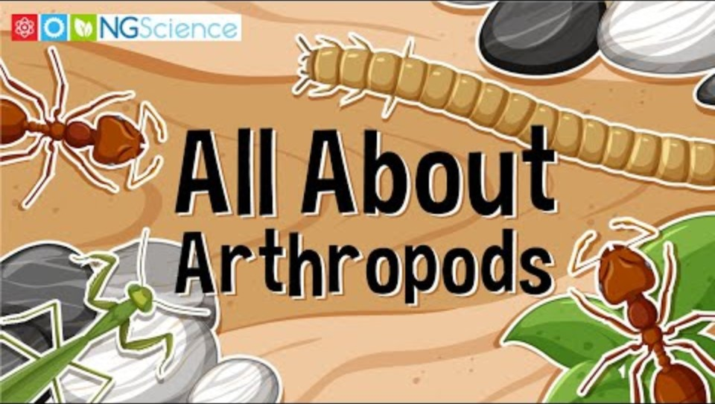

Slide 7
Groups of arthropods
Insects: 6 legs, 3 body parts
Arachnids: 8 legs, 2 body parts
Crustaceans: at least 10 legs, 2 body parts
Myrapods: many legs and body segments

Slide 8
Activity 1: Specimen analysis
Do not shake or tip the jars!
Draw and describe each animal you study (in particular, describe the number of legs and body parts)

Slide 9
Success criteria
Describe features of arthropods, and their subgroups (insects, arachnids, crustaceans and myrapods).
Give examples of insects, arachnids, crustaceans and myrapods.

